Slide 1
4 keys of fun, genre, demographic, theme
Demographic
25 – 35 year old males.
Jesse Schell states that “At this age, time starts to become more precious. This is the age of “peak family formation.” As the responsibilities of adulthood start to add up, most adults in this age bracket are only casual game players, playing games as an occasional amusement, or playing games with their young children. On the other hand, “hardcore gamers” in this age bracket — that is, people for whom playing games is their primary hobby — are an important target market because they purchase a lot of games, and are often quite vocal about what they do and don’t like, potentially influencing the buying decisions of their social network. ” (The Art of Game Design, 2008, p.101).
According 2017 Video Game Trends and Statistics – Who’s Playing What and Why? Krista Lofgren states “The average age of gamers: 35” and “Male gamers: 59% and female gamers: 41%.”
Genre
Shoot ‘em Up/Shmup (Bullet-Hell.)
4 Key of fun
Hard Fun
Theme
Rescue

Slide 2
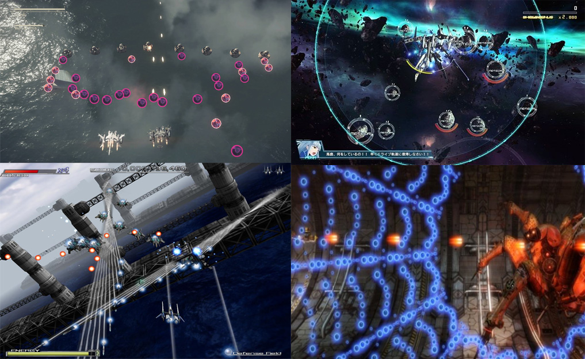
Mood-board

Slide 3
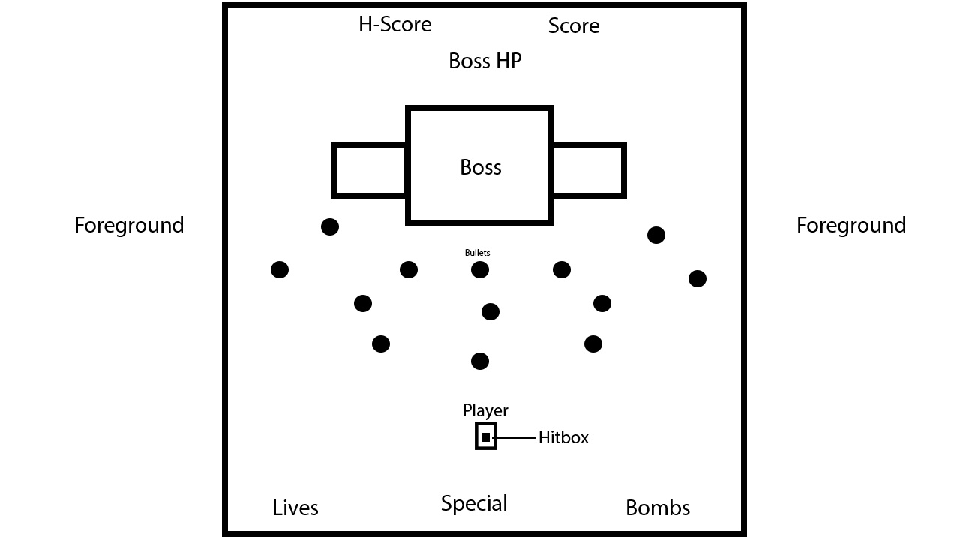
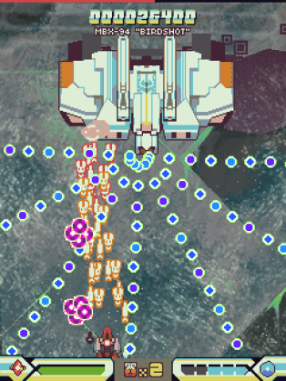
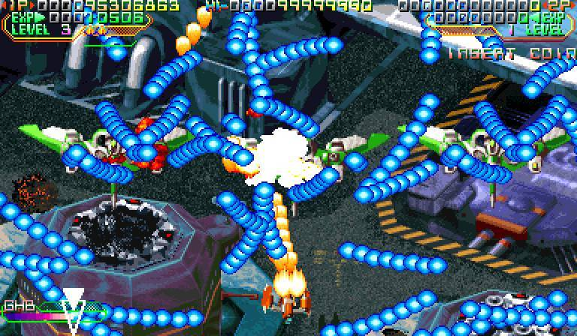
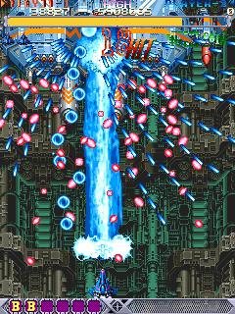
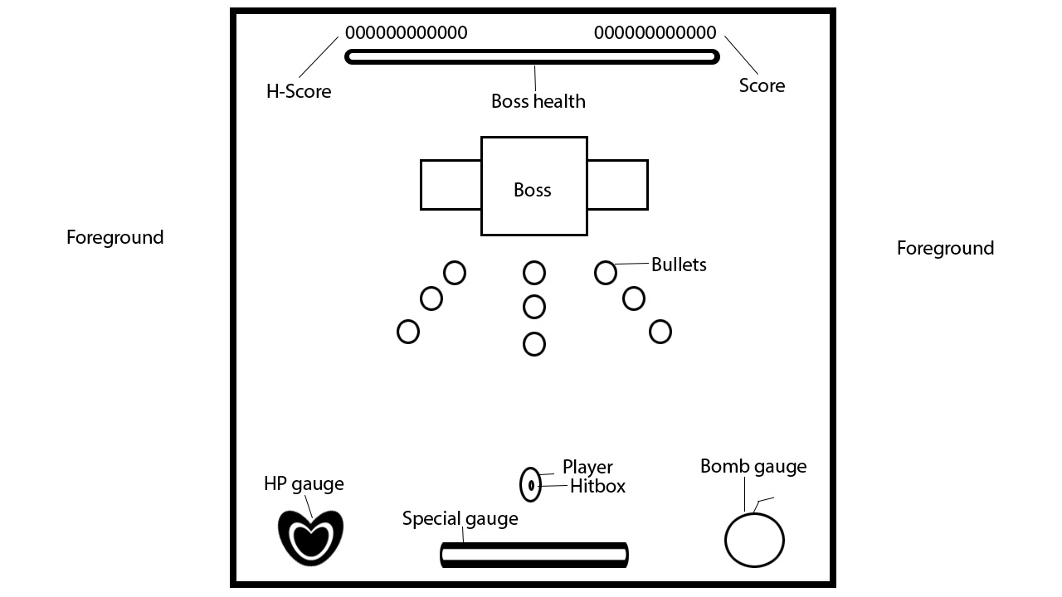
Concept

Slide 4
Unique Selling Points
2.5D environments and a captivating narrative tied to the theme.
Charming direction
Four types of challenging game difficulty

Slide 5
References
Schell, J. (2015). The art of game design. 2nd ed. Boca Raton: CRC Press, p.101.
Lofgren, K. (2017). 2017 Video Game Trends and Statistics - Who's Playing What and Why?. [online] Big Fish Games. Available at: http://www.bigfishgames.com/blog/2017-video-game-trends-and-statistics-whos-playing-what-and-why/ [Accessed 8 Oct. 2017].

